Slide 1

The National University of Computer and Emerging Sciences
Introduction to 2D Arrays
CS 1002 Programming Fundamentals
Dr. Akhtar Jamil
Department of Computer Science

Slide 2
Goals
Review Of Previous Lecture
Introduction to Arrays

Slide 3
Previous Lecture

Slide 4
Copying Arrays
Can you copy array using a syntax like this?
int list[3];int myList[3];
list = myList; //Wrong
Copy individual elements from one array to the other as follows:
for (int i = 0; i < 3; i++) {
list[i] = myList[i];
}

Slide 5
C-Strings or Character Arrays
The elements of an array can be just about anything (any-datatype)
Consider an array whose elements are all characters (char type)
Called a C-String
Treated differently for I/O than other types of arrays

Slide 6
Declaration of C-Strings
Similar to declaration of any array:
char name[30]; // no initialization
char title[20] = “Hello World";
//initialized at declaration with a string
char chList[6] = {‘H', ‘e', ‘l', ‘l‘, ’o’}; //initialized with list of char values

Slide 7
Initializing Character Arrays
char city[ ] = “LAHORE";

Slide 8
Printing Character Array
For a character array, it can be printed using one print statement.
Character arrays are handled differently than other types of arrays
For example:
char city[ ] = “Lahore";
cout << city; //Correct
int marks [ ] = {20,65,30};
cout << marks; //Wrong

Slide 9
Today’s Lecture

Slide 10
Two Dimensional Arrays

Slide 11
Two Dimensional Arrays
A two dimensional array stores data as a logical collection of rows and columns
Each element of a two-dimensional array has a row position and a column position (indicated by two indexes)
To access an element in a two-dimensional array, you must specify the name of the array followed by:
a row index
a column index

Slide 12
Declaration and Initialization
Declaration of a two-dimensional array requires a row size and a column size
A consecutive block of (row size)*(column size) memory locations are allocated.
All array elements must be of the same type.
Elements accessed by two offsets: a row offset and a column offset.

Slide 13
2D Array - Example
//Declaration
int data[2][3];
col 0
col 1
col 2
row 0
? | ? | ?
? | ? | ?
row 1

Slide 14
Declaring 2D Arrays
datatype arrayName[rowSize][coulmnSize];
Example:
double myList[2][4];
rowSize, and coulmnSize: MUST BE constant
- constant literal
- constant identifier

Slide 15
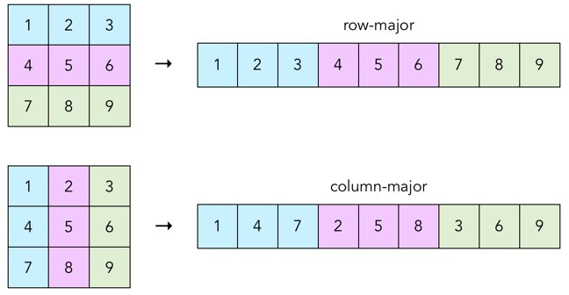
2D Arrays in Memory
Two Possibilities:
Row-major order
Column-major order
C/C++ follows row-major order
https://craftofcoding.files.wordpress.com/2017/02/rowcolumnarrays.jpg

Slide 16
Declaring and Initializing Arrays
int myList[3][2]={{22,33}, {44,55}, {66,77}};
→ myList has 3 Rows and 2 coulmns in each row:
Coulmn Indexes
0 1
0
1
2
22 | 33
44 | 55
66 | 77
Row Indexes

Slide 17
Initialization Examples
int temp[4][3] = {{50, 70, 60}, {48, 75, 62}, {51, 69, 60}, {52, 78, 63}};
int t2[7][4] = {{50, 70, 60}, {48, 75, 62}, {51, 69, 60}, {52, 78, 63}};
int temp[][3] = {{50, 70, 60}, {48, 75, 62}, {51, 69, 60}, {52, 78, 63}};

Slide 18
Example: Input Using cin
Nested for loops are often used when inputting and assigning values to a two-dimensional array
//Declaration
double table[10][10];
for (int i=0; i<10; i++) //every row
for (int j=0; j<10; j++) //every col
cin >> table[i][j];

Slide 19
Example: Assignment
//Declaration
const int RSIZE=3;
Const int CSIZE=2;
double v[RSIZE][CSIZE];
for (int i=0; i<RSIZE; i++) //every row
for (int j=0; j<CSIZE; j++ )//every col
v[i][j] = i+j;
V
0 | 1
1 | 2
2 | 3

Slide 20
Example: Computations
Compute the average value of an matrix with n rows and m columns.
double sum=0;
double average;
for (int i=0; i<n; i++) //every row
for (int j=0; j<m; j++ )//every col
sum += array[i][j];
average = sum / (n*m);

Slide 21
2D Array Example-1
Compute the average value of the 3rd row of a 2D array with r rows and c columns.
double sum=0;
double rowAverage;
for (int j=0; j<c; j++) //every col
sum += array[2][j];
average = sum / c;

Slide 22
Outputting 2D Arrays
Two dimensional arrays are often printed in a row by row format, using nested for statements.
for (int i=0; i<n; i++)
{
//every row
for (int j=0; j<m; j++ )//every col
cout << array[i][j] << ‘ ‘;
cout << endl; //add end-of-line each row
}

Slide 23
Higher-Dimensional Arrays
- An array can be declared with multiple dimensions.
2 Dimensional 3 Dimensional
double Coord[100][100][100];
- Multiple dimensions get difficult to visualize graphically.
•
Single
value
1D Array
2D Array
3D Array

Slide 24
Larger-Dimension Arrays
Arrays with more than two dimensions allowed in C++ but not commonly used
Example: int ThreeD[4][10][6];
First element: ThreeD[0][0][0]
Last element:ThreeD[3][9][5]

Slide 25
(Nested Loops) – Example Program-1
Write a program to that creates a matrix of size 5 by 5 (5 Columns, and 5 Rows). The program should ask the user to enter values in each matrix element. Then the program should display the matrix Row-wise.
Example:
1, | 2, | 3, | 4,
5, | 6, | 7, | 8,
9, | 10, | 11, | 12,
13, | 14, | 15, | 16,
1 | 2 | 3 | 4
5 | 6 | 7 | 8
9 | 10 | 11 | 12
13 | 14 | 15 | 16
Output

Slide 26
(Nested Loops) – Example Program-2
Write a program to that creates a matrix of size 5 by 5 (5 Columns, and 5 Rows). The program should ask the user to enter values in each matrix element. Then the program should display the matrix Coulmn-wise.
Example:
1, | 5, | 9, | 13,
2, | 6, | 10, | 14,
3, | 7, | 11, | 15,
4, | 8, | 12, | 16,
1 | 2 | 3 | 4
5 | 6 | 7 | 8
9 | 10 | 11 | 12
13 | 14 | 15 | 16
Output

Slide 27
Example: Transpose
Write a program that creates a matrix of 4x4 (4 rows, and 4 coulmns). Get input values from the user for the complete matrix. The program should calculate transpose of matrix and display it.

Slide 28
(Nested Loops) – Example Program-3
Write a program to that creates a matrix of size 10 by 10 (10 Columns, and 10 Rows). The program should ask the user to enter values in each matrix element. Then the program should display the left-diagonal elements of the matrix.
Example (5 by 5 matrix):
1 | 2 | 3 | 4
5 | 6 | 7 | 8
9 | 10 | 11 | 12
13 | 14 | 15 | 16
Output
1, | 6, | 11, | 16,

Slide 29
Example-4: Zero Matrix
Write a program that creates a matrix of 3 by 3 (3 rows, and 3 coulmns). Get input values from the user for the complete matrix. Then, the program should determine whether the matrix is a “Zero” matrix (all elements are zero) or not.

Slide 30
Example-5: Coulmn sum
Write a program that creates a matrix of 4x4 (4 rows, and 4 coulmns). Get input values from the user for the complete matrix. The program should calculate and print the sums of each individual coulmn.

Slide 31
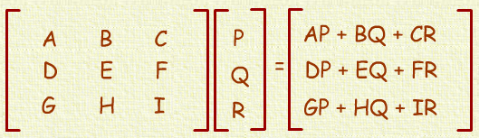
Example-6: Matrix Vector
Write a program that creates a matrix of 7 by 7 (7 rows and 7 coulmns). Create a 1D array having 6 elements. The program should multiply the matrix with the given vector and print the resultant matrix in proper format.

Slide 32
Example-6: Matrix Vector-code
int A[4][4];
int B[4]; int C[4]; int r;
// Get input in the “A” matrix and “B” array
for(int i=0; i<4; i++)
{
r = 0;
for(int j=0;j<4; j++)
r = r + A[i][j] * B[j];
C[i] = r;
}

Slide 33
Thank You ☺

